Slide 1


Airbnb Booking Analysis
Namira Mujawar
(DBATU Final Year Computer Engineering Student)

Slide 2


Points for Discussion
Introduction of Problem Statement
Business Objective
Dataset
Variables Description
Manipulations I have done and insights I found?
Charts
The Solution to Business Objective
Conclusion

Slide 3
Introduction of Problem Statement
Since 2008, guests and hosts have used Airbnb to expand on traveling possibilities and present a more unique, personalized way of experiencing the world. Today, Airbnb became one of a kind service that is used and recognized by the whole world.
Data analysis on millions of listings provided through Airbnb is a crucial factor for the company.
These millions of listings generate a lot of data that can be analyzed and used for security, business decisions, understanding of customers’ and providers’ (hosts’) behavior and performance on the platform, guiding marketing initiatives, implementation of innovative additional services, and much more.
This dataset has around 49,000 observations with 16 columns and is a mix of categorical and numeric values. Explore and analyze the data to discover key understandings.

Slide 4
Business Objective
Understanding the market demand
Optimizing the pricing strategy
Improving customer experience.
Identifying new business opportunities

Slide 5
Dataset
Airbnb booking analysis dataset typically contains information about Airbnb bookings in a particular location, including the listing description, booking date, number of guests, price, and other related attributes. The dataset consists of 49,000 rows and 16 columns.
Some attributes found in the Airbnb booking analysis dataset include:
Booking information
Pricing information
Reviews and ratings
Host information

Slide 6
Variables Description
Variables found in an Airbnb booking analysis dataset:
Host ID: A unique identifier for the Airbnb host.
Listing name: The name of the Airbnb listing. Neighborhood: The neighborhood where the Airbnb listing is located.
Latitude and Longitude: The geographical coordinates of the Airbnb listing.
Room type: The type of room available for booking, such as private room, shared room or entire home/apartment.
Price: The nightly price of the Airbnb listing.
Minimum nights: The minimum number of nights required to book the Airbnb listing.
Ratings: The overall rating and review scores of the Airbnb listing, as rated by previous guests.
Host response rate: The rate at which the Airbnb host responds to inquiries and booking requests.

Slide 7
Manipulations I have done and insights I found?
Handling missing values: Missing values can be handled using techniques such as imputation, substitution, or removal.
Removing duplicates: Duplicates can be removed to ensure that the analysis is based on unique data points.
Handling outliers: Outliers can be handled by removing or replacing them with more appropriate values.
Converting data types: The data types of the variables can be converted to ensure that they are in a consistent format for analysis.
Merging and splitting data: Data can be merged or split to create new variables or group data points for analysis.
Insights from Airbnb Booking Analysis Data:
Price distribution: The analysis can provide insights into the distribution of prices for Airbnb listings in a particular location, identifying the range and median prices.
Seasonal patterns: The analysis can reveal the seasonal patterns of Airbnb bookings, such as peak booking periods during holidays or special events.
Location preferences: The analysis can identify the most popular neighborhoods or locations for Airbnb bookings, as well as the factors that influence these preferences.
Customer ratings and reviews: The analysis can provide insights into the overall satisfaction of customers with Airbnb listings, based on their ratings and reviews.

Slide 8
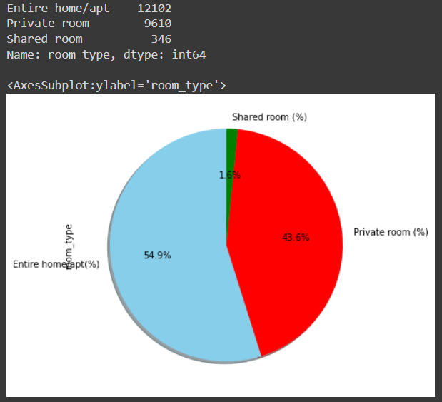
Charts

Slide 9
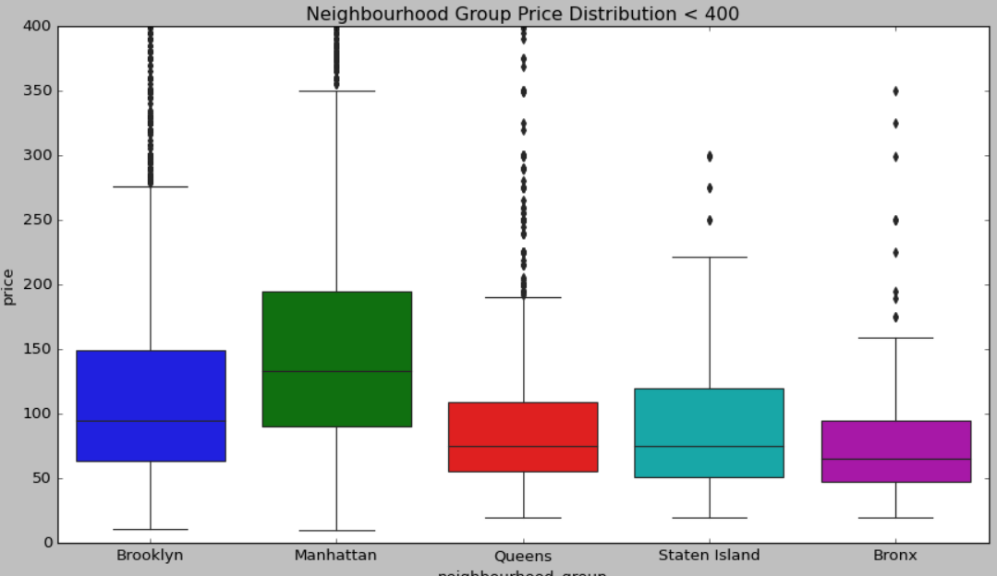
.
.

Slide 10
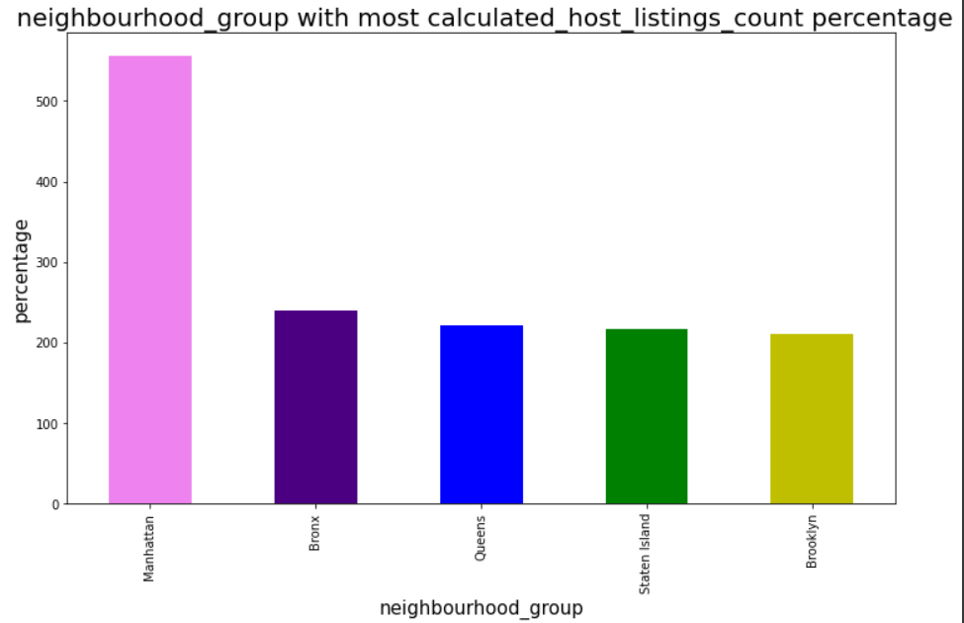
.
.

Slide 11
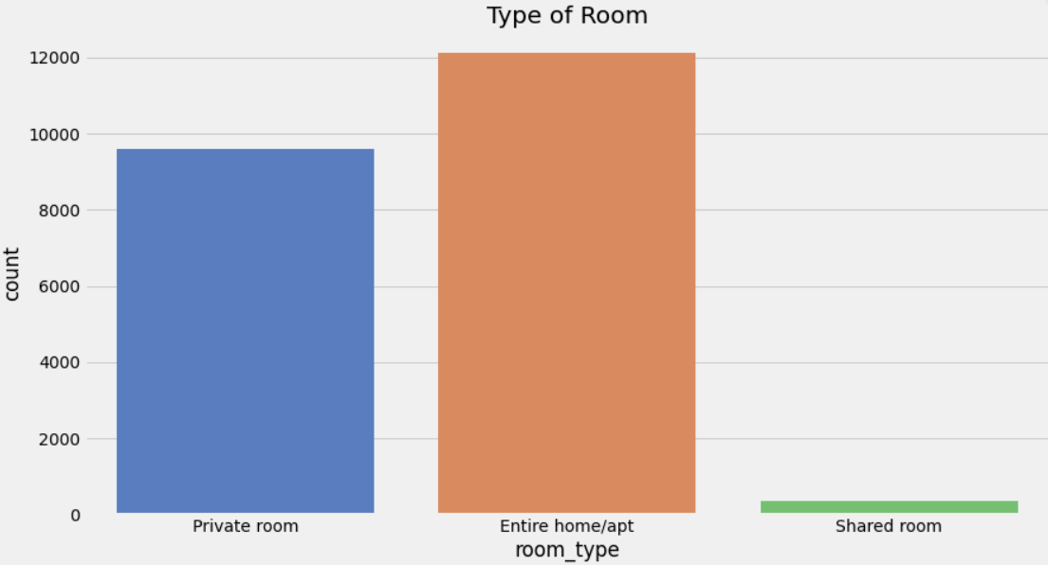
.

Slide 12
The solution to Business Objective
Based on the analysis of Airbnb booking data, there are several recommendations that could help the client achieve their business objectives:
Improve the quality of listings: As we found that there is a positive correlation between the number of reviews and the booking price, it is important for the client to focus on improving the quality of listings on their platform. They could provide more resources and guidance to hosts to help them create more attractive and high-quality listings.
Focus on popular neighborhoods: As Manhattan and Queens were found to be the most popular neighborhoods, the client could focus on acquiring more listings in these areas and improving the quality of existing listings. This could help increase bookings and revenue for the client.
Optimize pricing strategy: Based on the booking patterns and preferences of users, the client could optimize their pricing strategy to reflect the demand for different types of rooms and neighborhoods. They could use dynamic pricing to adjust prices during peak times and maximize revenue.
Improve user experience: To provide a better experience for their guests, the client could consider investing in technology and tools to improve the booking process and communication between hosts and guests. They could also provide more personalized recommendations to guests based on their preferences and booking history.
Expand to new markets: The client could consider expanding their platform to new markets or neighborhoods that are currently underserved by Airbnb. This could help them attract new hosts and guests and increase their revenue and market share.

Slide 13
Conclusion
In conclusion, the analysis of Airbnb booking data provides valuable insights into the booking patterns and preferences of users. Through the analysis of various variables such as the type of room, neighborhood, and pricing, we can identify trends and patterns that can help Airbnb optimize its business strategy and provide a better experience for its users.
We found that entire apartments were the most popular type of room booked by guests, followed by private rooms and shared rooms. Additionally, we found that Manhattan and Queens were the most popular neighborhoods, with the highest number of listings per host. We also discovered that there was a positive correlation between the number of reviews and the booking price, suggesting that guests were willing to pay more for higher-quality listings.
Overall, this analysis provides valuable insights into the Airbnb platform and can help the company make data-driven decisions to optimize its business strategy and improve the user experience. By understanding the booking preferences of users, Airbnb can prioritize its efforts and resources to maximize revenue and provide a better experience for its hosts and guests.

Slide 14
Thank you

